Slide 1
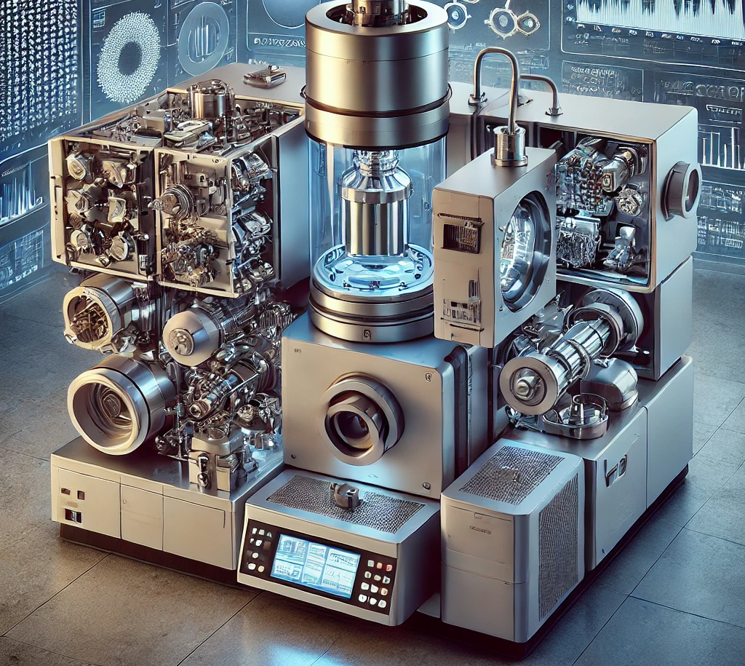
Mass Spectrometry
Cris Lana
Mass spectrometry (MS) is an analytical technique that separates ionized atoms, molecules, or clusters based on the differences in their mass-to-charge ratios (m/z).
This method allows for the determination of isotopes and their abundances.

Slide 2
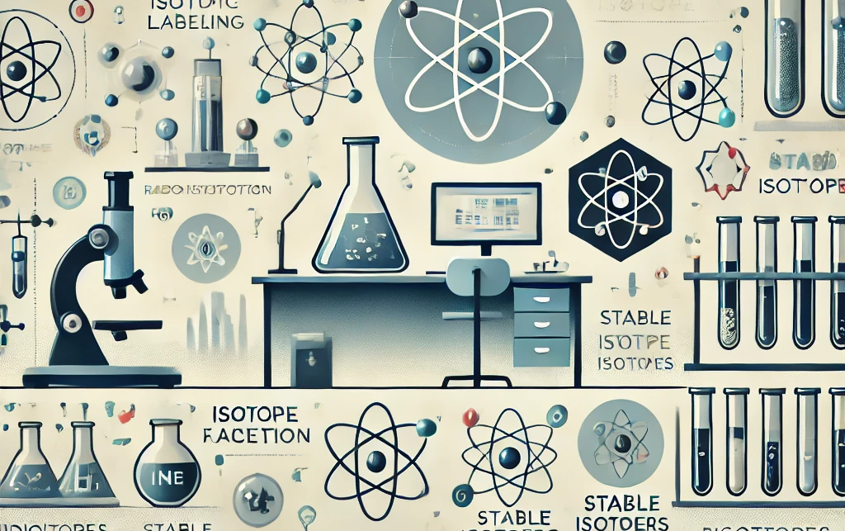
Mass Spectrometry - inorganic chemistry
Isotope mass spectrometry
Isotopes
IMS - is a specialized form of mass spectrometry used to measure the relative abundance of isotopes in a sample.
In isotope mass spectrometry, the sample is ionized, and the ions are separated based on their mass-to-charge ratios (m/z).
This technique is widely used in fields such as geochemistry, environmental science, biology, and archaeology to investigate isotopic ratios, which can reveal important information about processes like age dating (e.g., U-Pb, C-14 dating), tracing biological pathways, or studying environmental changes.

Slide 3

Mass Spectrometry – organic chemistry
Molecular mass spectrometry
Water molecules
MMS - is a technique used to analyse and identify molecules based on their mass-to-charge ratio (m/z).
In this process, molecules are ionized, typically by techniques such as electron impact, electrospray ionization, or matrix-assisted laser desorption/ionization (MALDI).
The ionized molecules are then passed through a mass analyzer, where they are separated according to their mass-to-charge ratio. This allows for the precise determination of the molecular weight and the identification of molecular structures, including complex organic compounds, proteins, and polymers. Molecular mass spectrometry is widely used in biochemistry, pharmaceuticals, and environmental science for tasks such as protein sequencing, drug development, and pollutant analysis.

Slide 4
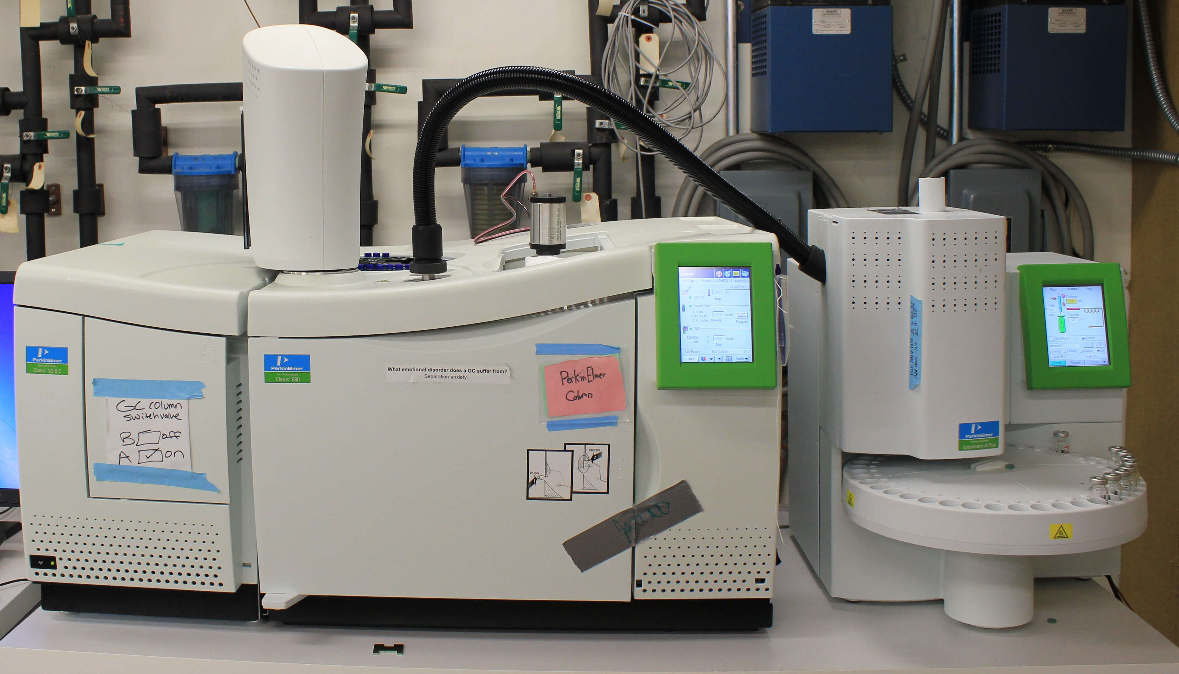
Mass Spectrometry – Molecular Characterization and Analysis Complex – MARYLAND UNIVERSITY

Slide 5
Mass spectrometers commonly used in geosciences:
Thermal Ionization Mass Spectrometer (TIMS)
Inductively Coupled Plasma Mass Spectrometer (ICP-MS)
Secondary Ion Mass Spectrometer (SIMS)
Accelerator Mass Spectrometer (AMS)
Gas Source Mass Spectrometer (GS-MS)

Slide 6
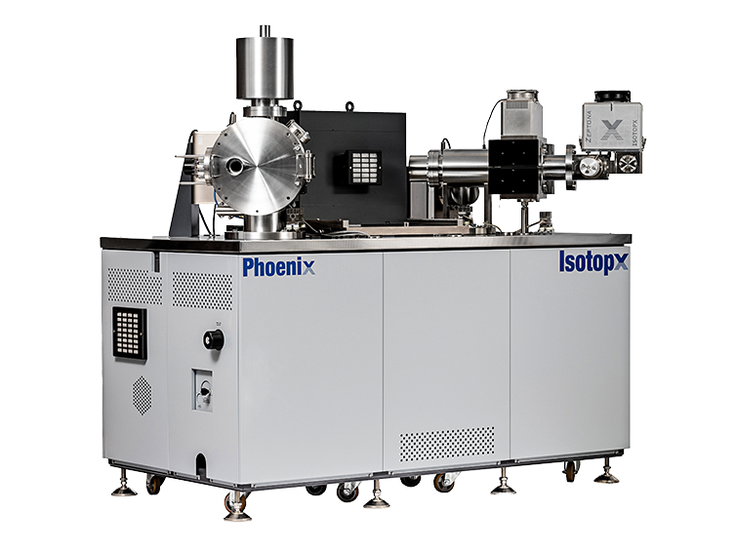
Thermal Ionization Mass Spectrometer (TIMS)
Applications:
U-Pb, Sm-Nd, Rb-Sr, and Lu-Hf geochronology and isotope geochemistry.
Working Principle: Sample ions are generated by heating, and isotopic ratios are determined by their mass-to-charge ratio.
Key Features: High precision for radiogenic isotope ratios, making it ideal for dating minerals such as zircons, carbonates, and silicates.

Slide 7
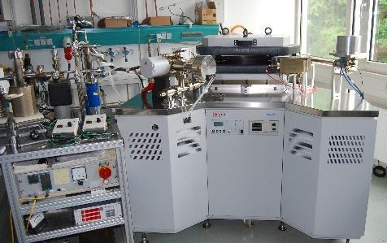
Gas Source Mass Spectrometer (GS-MS)
Applications: Stable isotope analysis (e.g., δ13C, δ18O, δD) in gases such as CO2, CH4, or water vapor.Working Principle: Gaseous samples are ionized and their isotopic ratios are measured by separating ions according to their mass-to-charge ratios.Key Features: Used extensively in paleoclimate studies, hydrology, and carbon cycle research.

Slide 8
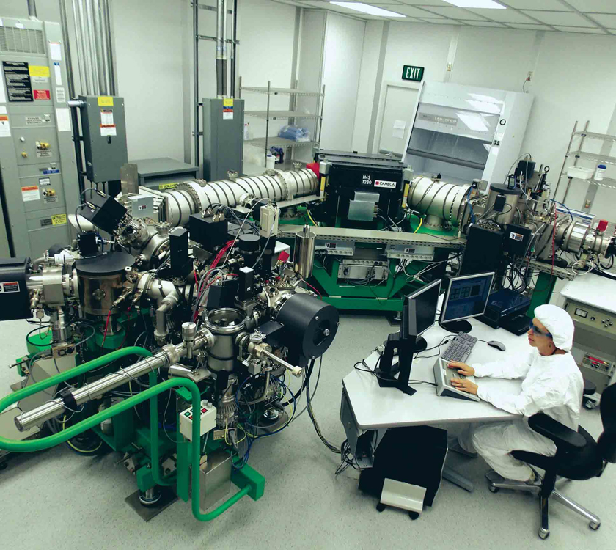
Secondary Ion Mass Spectrometer (SIMS)
Applications: In situ U-Pb dating, stable isotope analysis (e.g., O, H, C isotopes), trace element and isotopic analysis of minerals.Working Principle: A focused ion beam is used to sputter atoms from a sample surface, and the ejected ions are measured to determine isotopic ratios.Key Features: High spatial resolution, enabling analysis of specific mineral phases and inclusions.

Slide 9
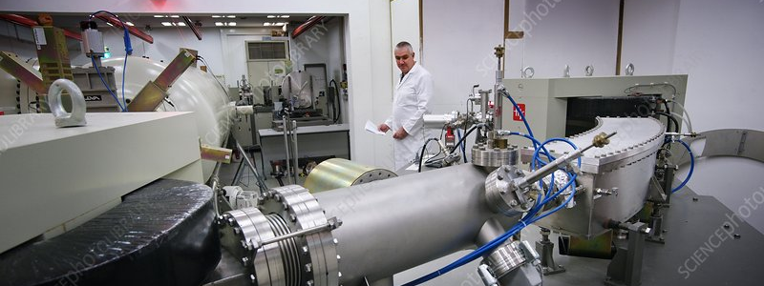
Accelerator Mass Spectrometer (AMS)
Applications: Radiocarbon dating, cosmogenic nuclide dating (e.g., 10Be, 26Al), and isotopic studies in paleoenvironmental research.
Working Principle: Measures the ratios of rare isotopes by accelerating ions to extremely high kinetic energies and separating them based on mass and charge.
Key Features: Capable of detecting very low concentrations of long-lived isotopes, making it ideal for radiocarbon and cosmogenic isotope studies.

Slide 10
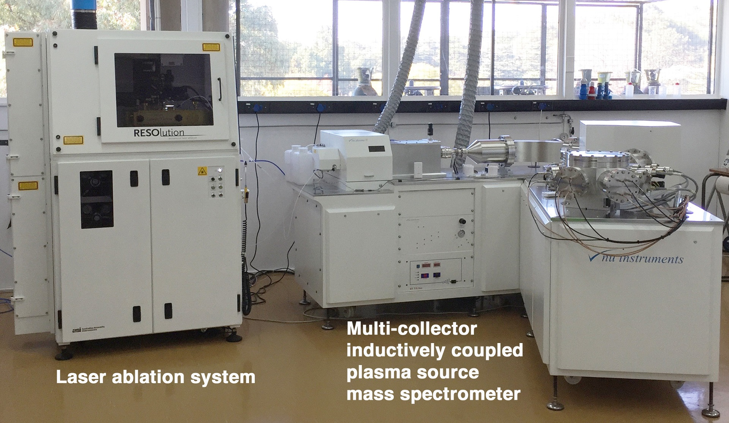
Multi-Collector ICP-MS (MC-ICP-MS)
Applications: High-precision isotope ratio analysis (e.g., Sr, Nd, Hf, Pb isotopes) in both solid and liquid samples.Working Principle: Similar to ICP-MS, but equipped with multiple detectors that simultaneously measure different isotopes, enhancing precision.Key Features: Widely used for isotopic studies in geochronology, crustal evolution, and provenance analysis.

Slide 11
What is Isotope Mass Spectrometry?
Isotope mass spectrometry is a powerful and precise analytical technique used to measure the relative abundances of different isotopes within a sample.
It offers insights into both the isotopic composition and processes that govern elemental behavior.
Isotopes, which are variants of the same element differing in the number of neutrons in their nuclei, have different atomic masses, allowing them to be separated and analysed using mass spectrometry.
Isotope mass spectrometry is distinguished by its high sensitivity, allowing for the detection of isotopes in very low concentrations. This precision makes it indispensable in studies requiring detailed isotopic information, providing insight into natural processes, material origins, and historical events on both atomic and planetary scales.

Slide 12
Some Applications
Geochronology: By measuring isotopic ratios of radioactive parent and daughter isotopes (e.g., U-Pb, Rb-Sr systems), researchers can determine the age of rocks, minerals, and meteorites.
Paleoclimatology: The ratios of stable isotopes (e.g., oxygen and carbon isotopes) are used to reconstruct past climate conditions, as isotopic fractionation in natural processes records temperature and environmental changes over time.
Biogeochemistry: Isotopic analyses help trace nutrient cycles in ecosystems, track pollutant sources, and study metabolic pathways in biological systems.
Forensic Science: Isotope ratios can be used to trace the origin of materials, such as food products or drugs, and assist in criminal investigations by linking evidence to specific geographic locations.

Slide 13
IONIZATION TYPES
1. Electron Ionization (EI)
2. Chemical Ionization (CI)
3. Electrospray Ionization (ESI)
4. Matrix-Assisted Laser Desorption/Ionization (MALDI)
5. Inductively Coupled Plasma (ICP) Ionization
6. Photoionization (PI)
7. Fast Atom Bombardment (FAB)
8. Thermal Ionization (TI)
9. Secondary Ion Mass Spectrometry (SIMS)

Slide 14
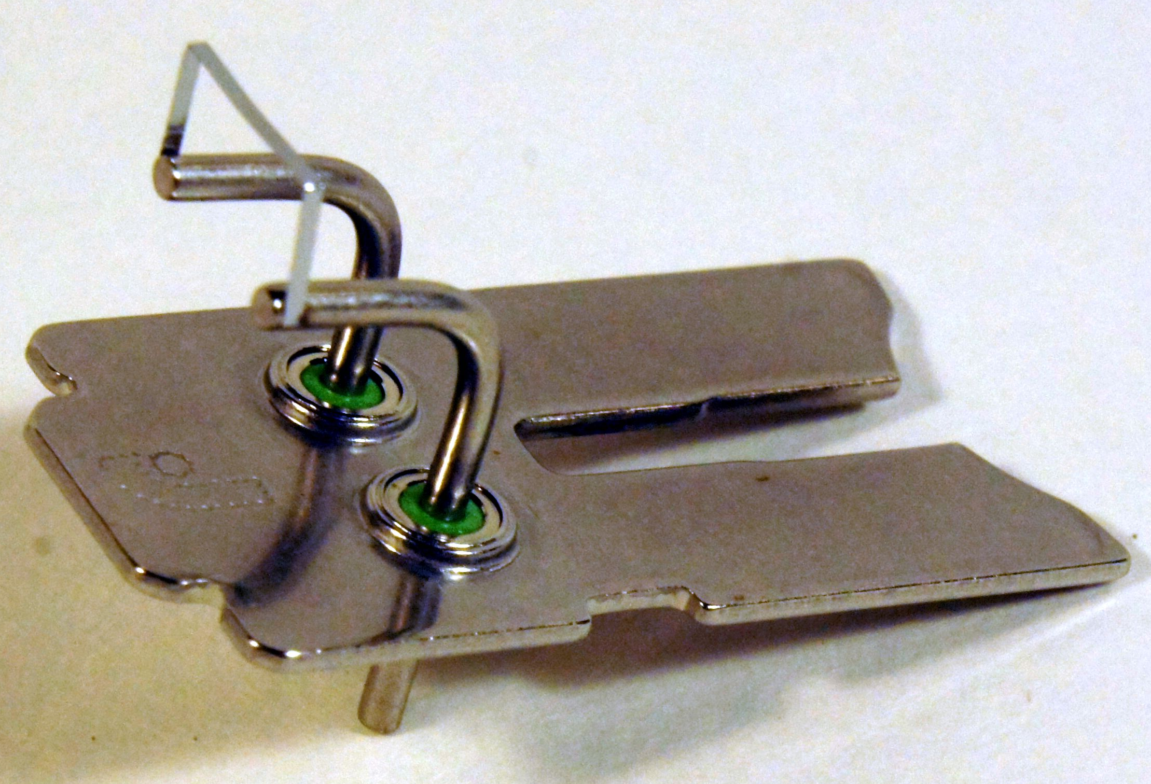
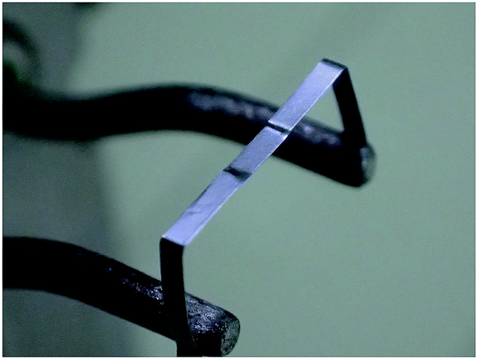
THERMAL IONIZATION
Thermal ionization is a technique used in mass spectrometry to ionize atoms by heating a sample on a metal filament, typically made of materials like rhenium or tantalum.
As the sample is heated to high temperatures, often exceeding 1,500°C, atoms in the sample are vaporized and ionized as they lose or gain electrons.
Thermal ionization is widely used in isotopic ratio studies, such as uranium-lead (U-Pb) and strontium-neodymium (Sr-Nd) dating in geochronology, due to its high precision and sensitivity. This method is particularly valued for its ability to produce very stable and consistent ion beams, making it ideal for analysing radiogenic isotopes in geological and environmental research.

Slide 15
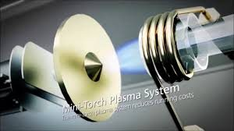
PLASMA IONIZATION
In this method, a sample is introduced into a high-temperature plasma (typically argon), which is generated by an electromagnetic field.
The intense heat of the plasma, reaching temperatures around 9,727°C, causes the sample to atomize and ionize, efficiently converting it into charged particles (ions).
ICP ionization is highly effective for detecting a wide range of elements, offering excellent sensitivity and accuracy. It is commonly used in fields such as geochemistry, environmental analysis, and material science, where precise trace element and isotope measurements are required.

Slide 16
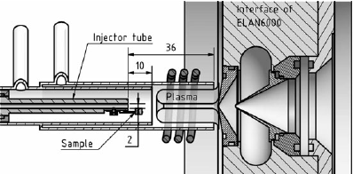
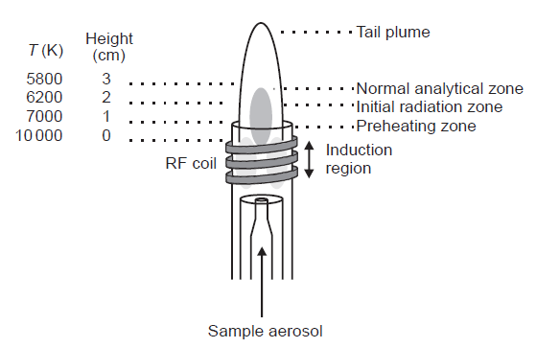
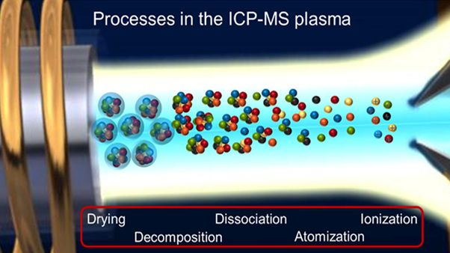

Slide 17
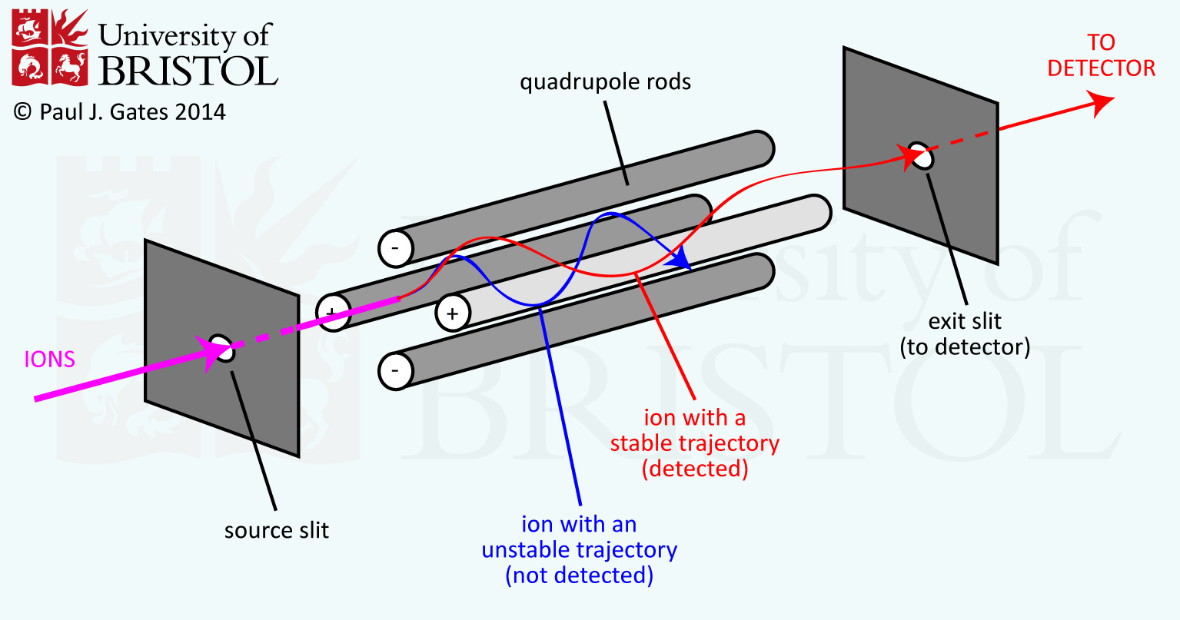
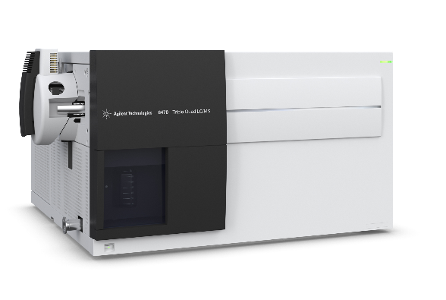
How does it work?
Inductively Coupled Plasma Mass Spectrometer

Slide 18
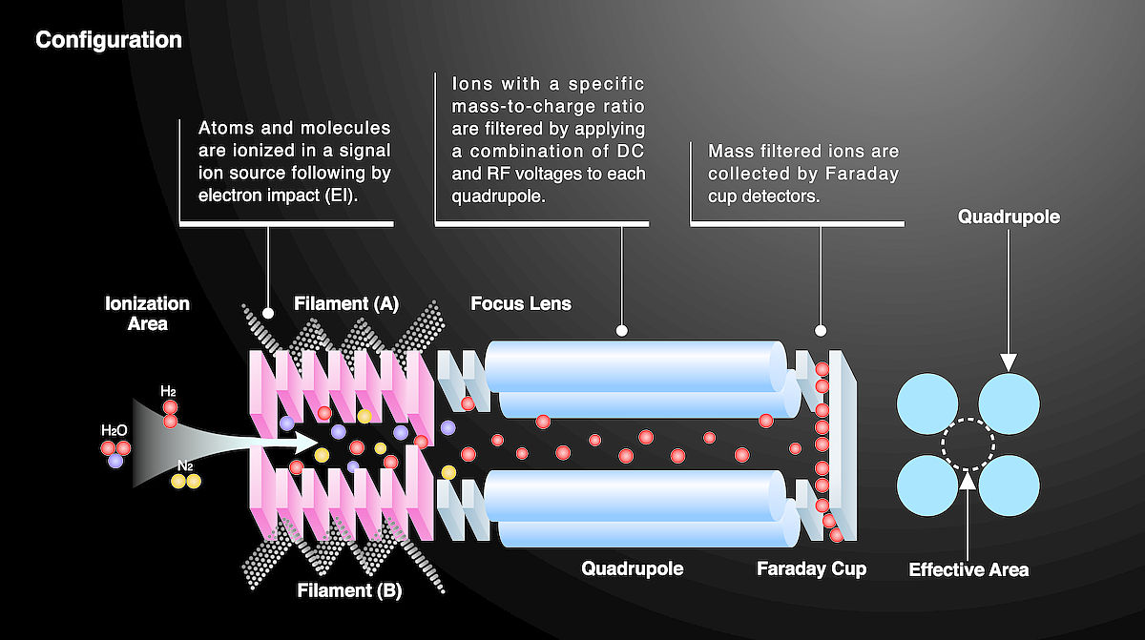
How does it work?
Inductively Coupled Plasma Mass Spectrometer

Slide 19
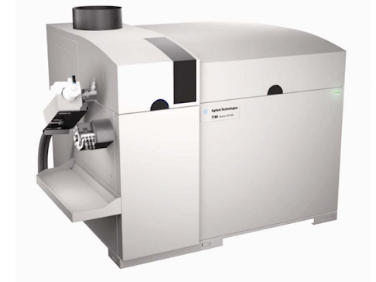
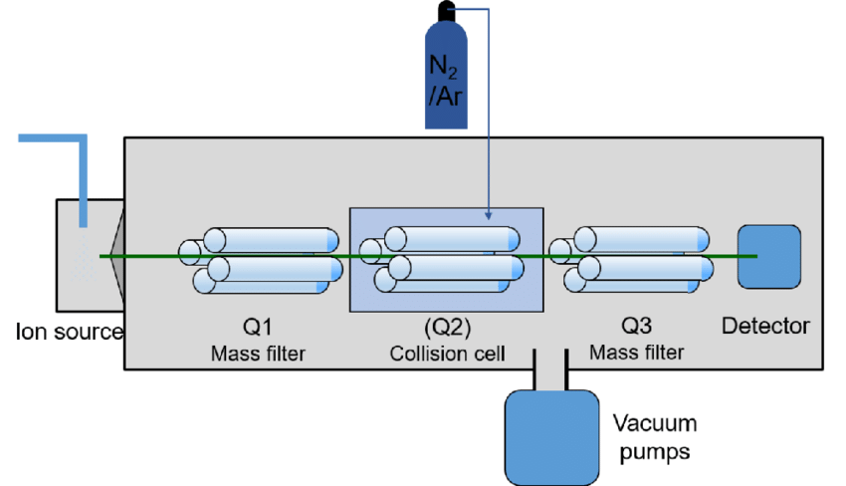
Triple Quadrupole ICP-MS
MORE SENSITIVE THAN CONVENTIONAL QUADRUPOLE ICP MS

Slide 20
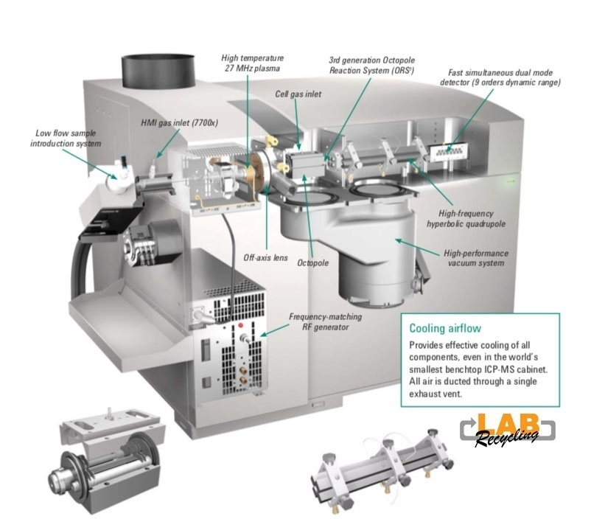

Slide 21
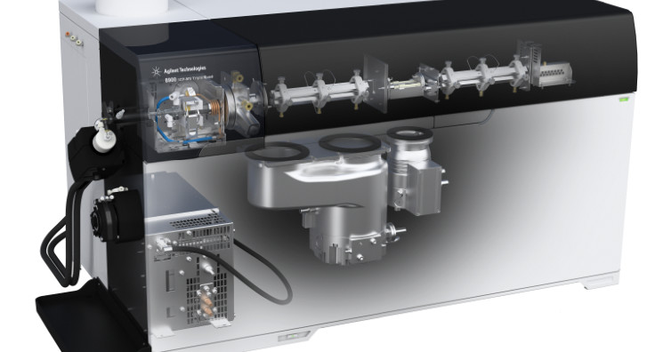

Slide 22
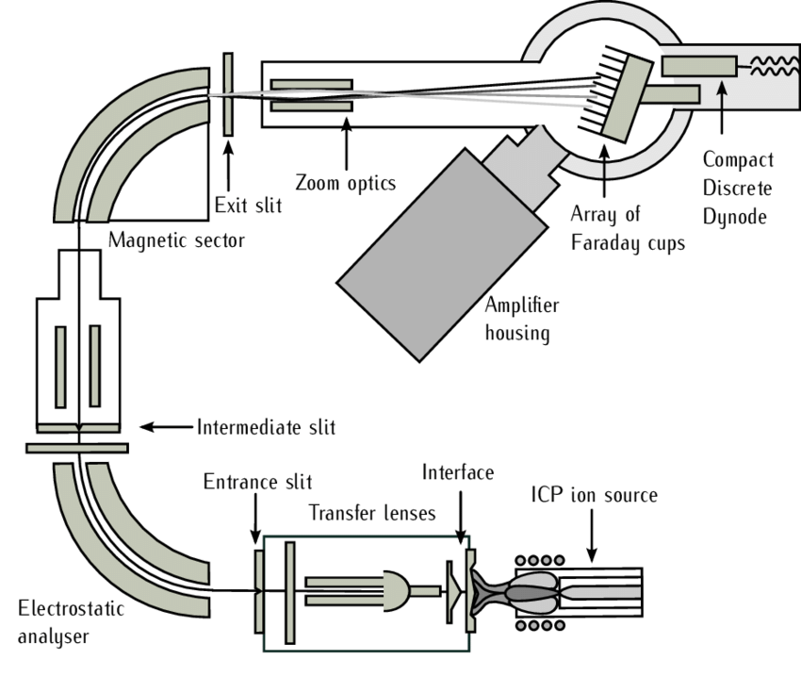
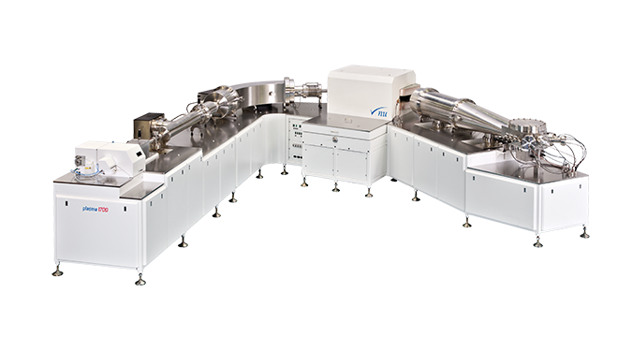
How does it work?
Inductively Coupled Plasma Mass Spectrometer

Slide 23
How does it work?
Inductively Coupled Plasma Mass Spectrometer

