Slide 1




Slide 2
Xrf fluorescence
Cris lana
Stellenbosch University

Slide 3
What is it for?
X-ray fluorescence (XRF) is an analytical technique used to determine the elemental composition of materials.
It is widely applied in various fields such as geology, material science, environmental analysis, and even in industrial applications for quality control.
We will dive into this technique to understand:
      what it is made of
      what it is used for
      how to work with it

Slide 4
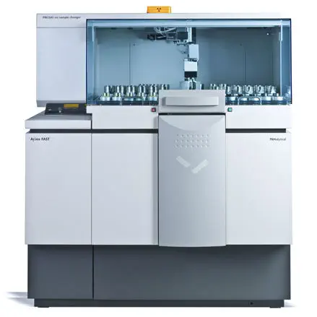
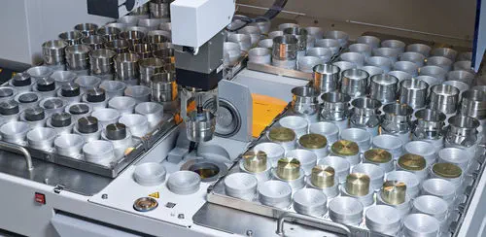
Main Components
X-ray Tube
High-Voltage Generator
Control Console
Automated Sample Holder

Slide 5
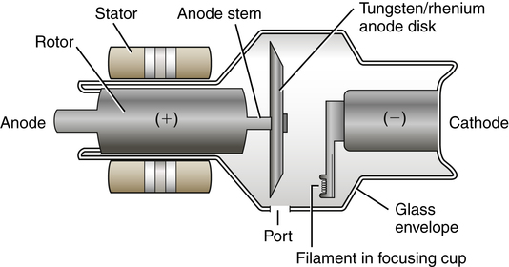
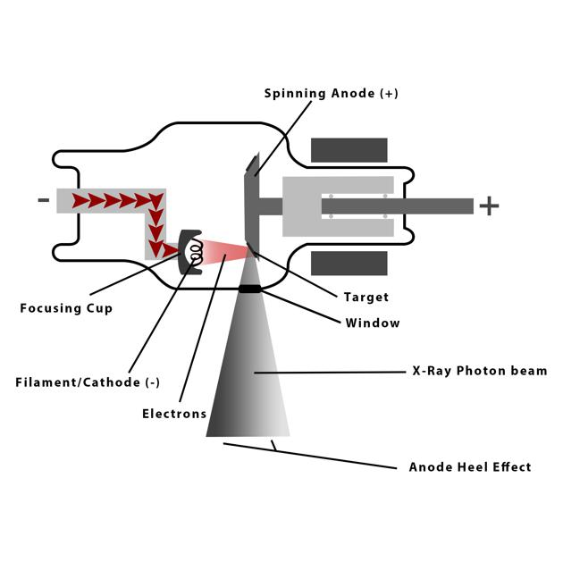
Main Components
X-ray Tube
The X-ray tube is the primary component responsible for generating X-rays. It is made up of an anode and a cathode.
When high voltage is applied across the cathode and anode, electrons are emitted and accelerated towards the anode. The sudden deceleration of these electrons at the anode produces X-rays.

Slide 6
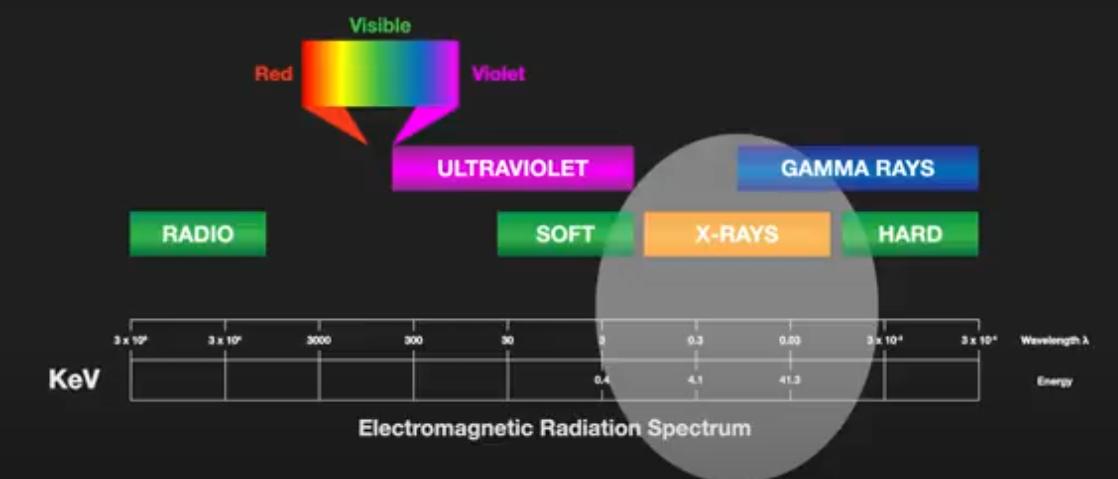
X-rays -

Slide 7
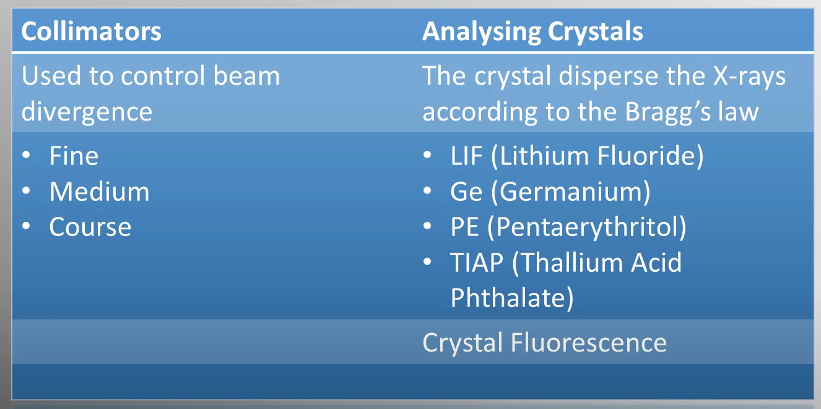
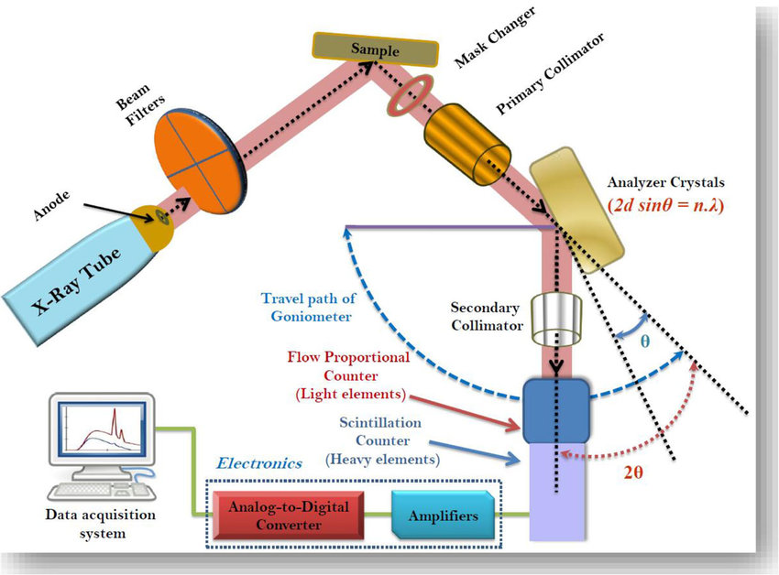

Slide 8
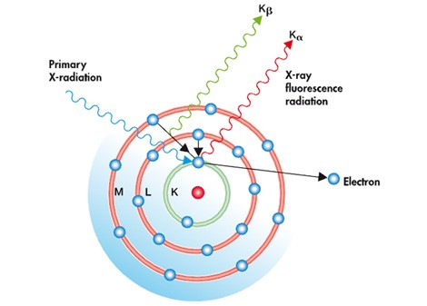
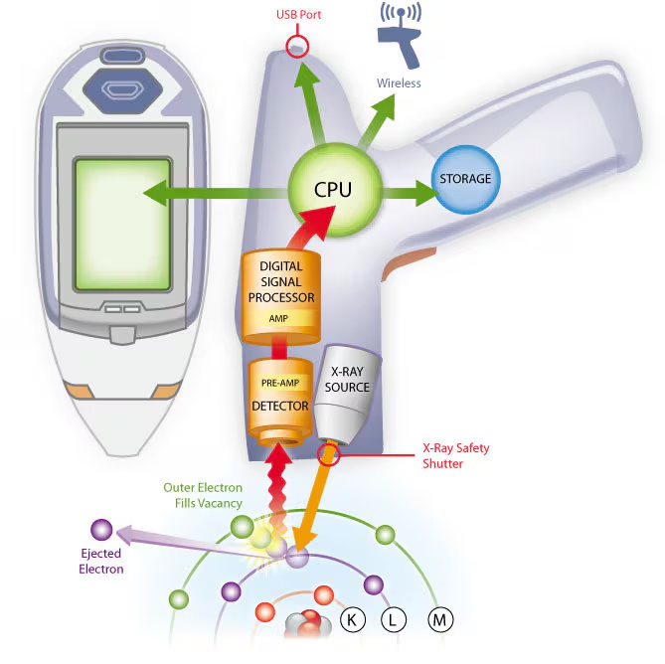
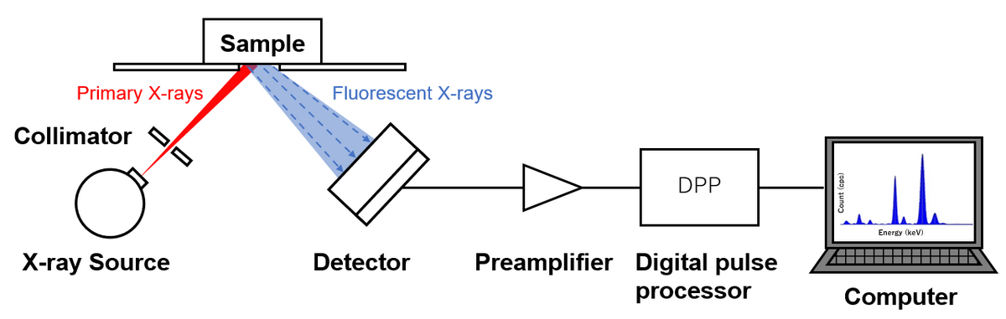
How things work inside

Slide 9
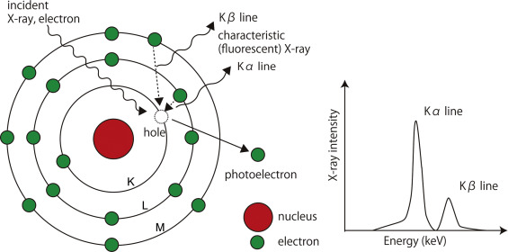

Slide 10
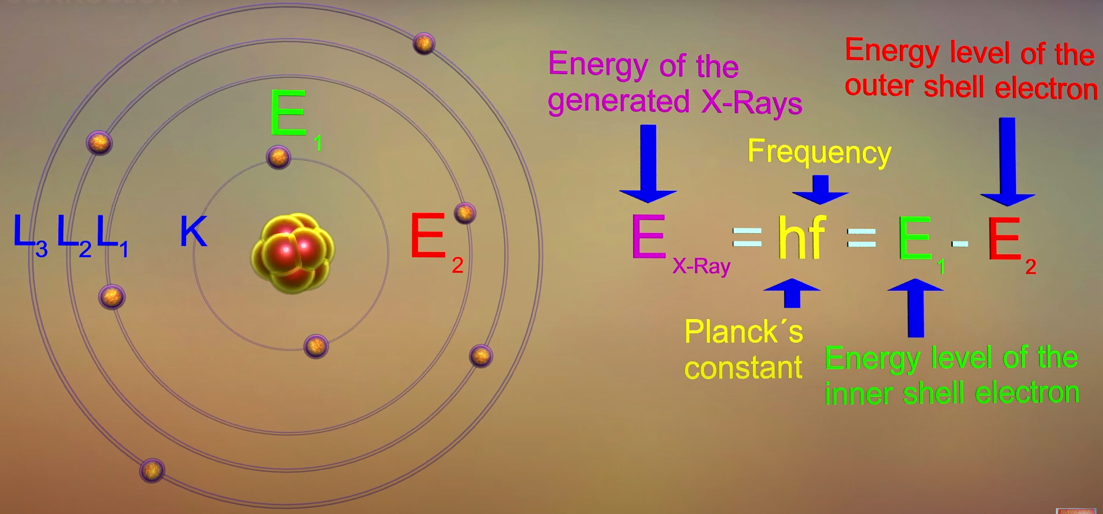

Slide 11
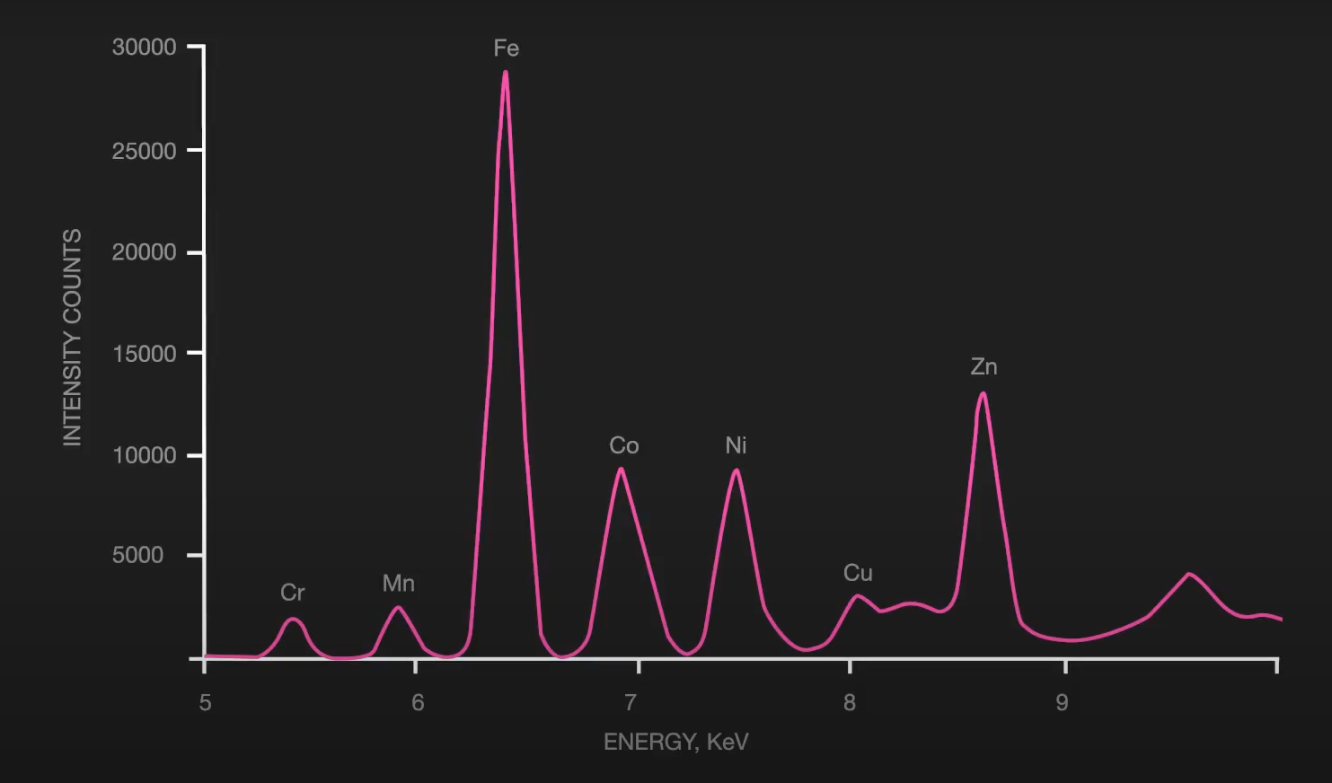

Slide 12
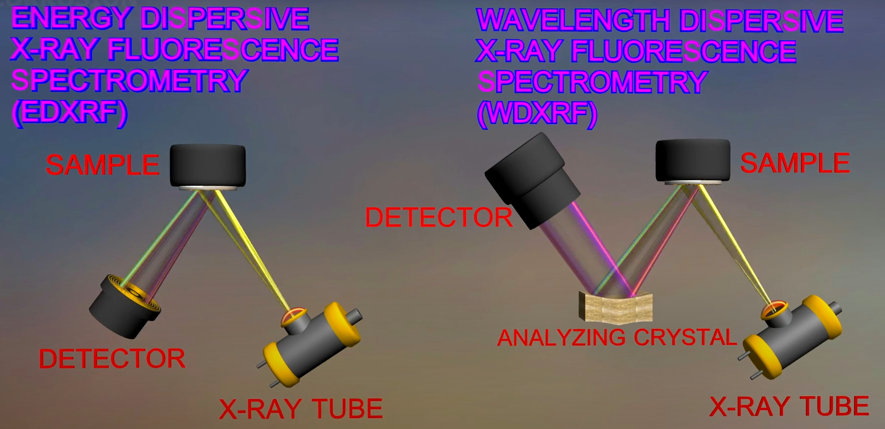
Two possible detectors

Slide 13
Energy Dispersive X-ray Fluorescence (EDXRF)
X-ray Excitation:
A sample is irradiated with a beam of primary X-rays, typically generated from an X-ray tube or a radioactive source.
These high-energy X-rays excite the atoms in the sample by knocking out inner-shell electrons (usually from the K or L shells).

Slide 14
Energy Dispersive X-ray Fluorescence (EDXRF)
Characteristic X-ray Emission:
As the electron drops to the lower energy level, it emits energy in the form of secondary X-rays. The energy of this emitted X-ray is unique to the specific element, making it possible to identify which elements are present in the sample.

Slide 15
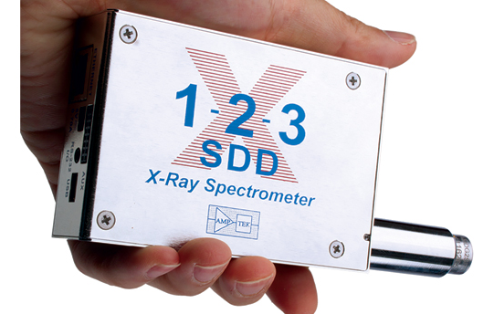
Energy Dispersive X-ray Fluorescence (EDXRF)
Energy Dispersive Detection:
In EDXRF, the emitted X-rays are detected by an energy-dispersive detector, such as a silicon drift detector (SDD).

Slide 16
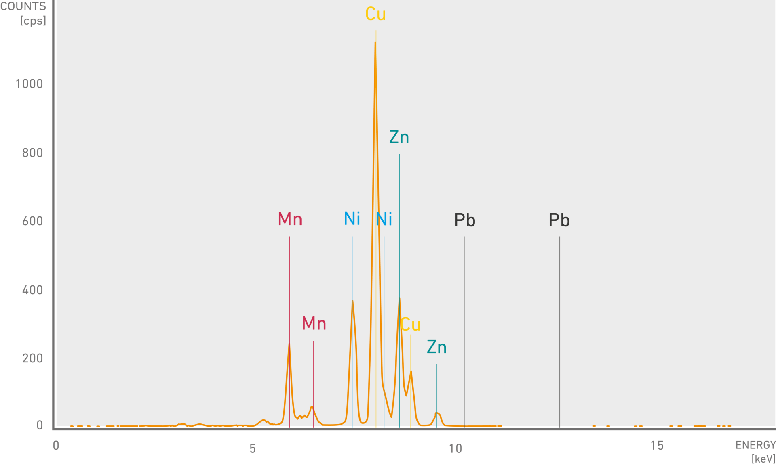
The detector measures the energy of the incoming X-rays, and this energy is directly related to the specific elements present.
The intensity of the X-rays at specific energy levels correlates with the concentration of the corresponding element in the sample.

Slide 17
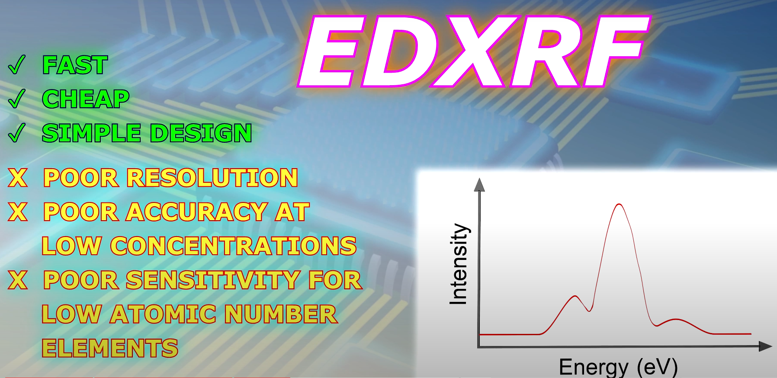

Slide 18
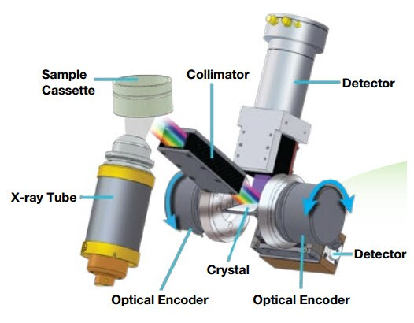
Wavelength Dispersive X-ray Fluorescence (WDXRF)
Instead of directly measuring the energy of the emitted X-rays (as in EDXRF), WDXRF uses a diffraction process to separate the X-rays by their wavelength.
A crystal analyzer (usually made from lithium fluoride or other specific materials) is used to diffract the emitted X-rays. The crystal acts like a prism, dispersing X-rays based on their wavelength according to Bragg's Law.
By adjusting the angle of the crystal, X-rays of specific wavelengths can be isolated and measured one at a time.

Slide 20
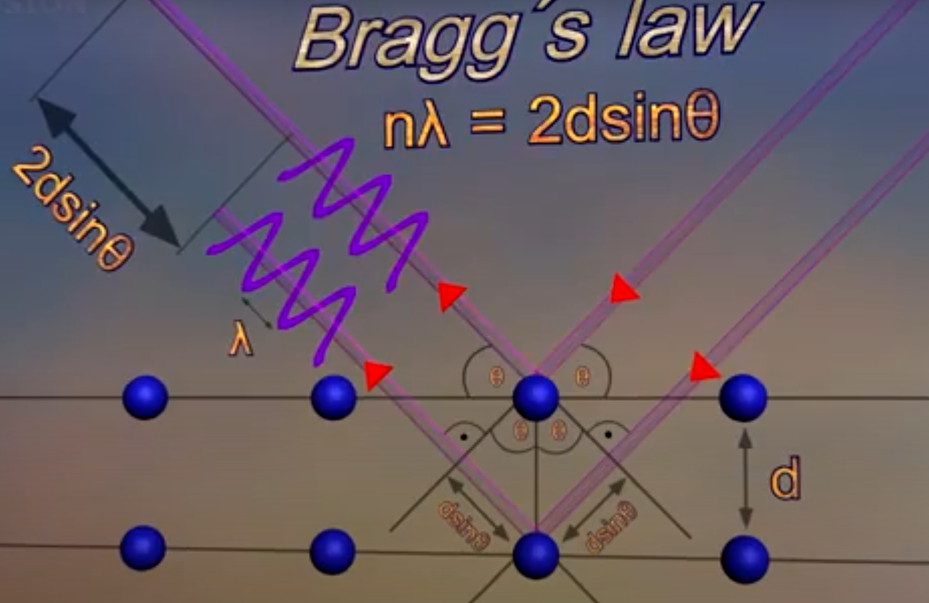

Slide 21
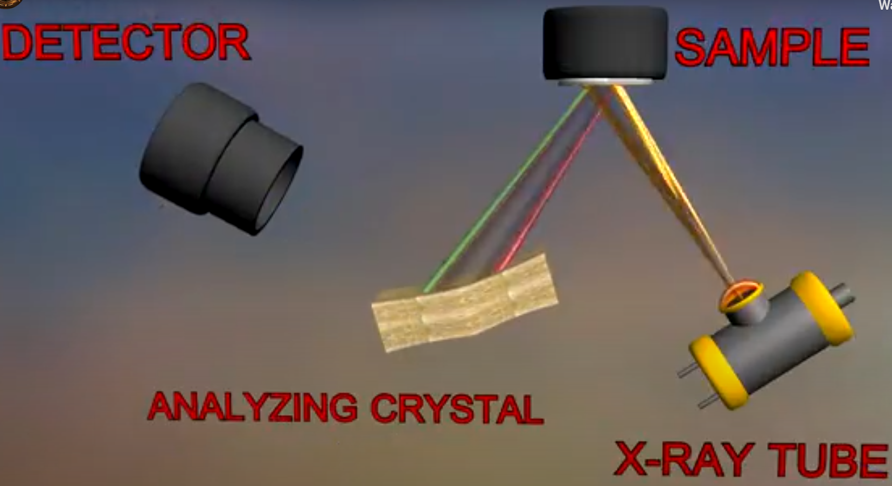
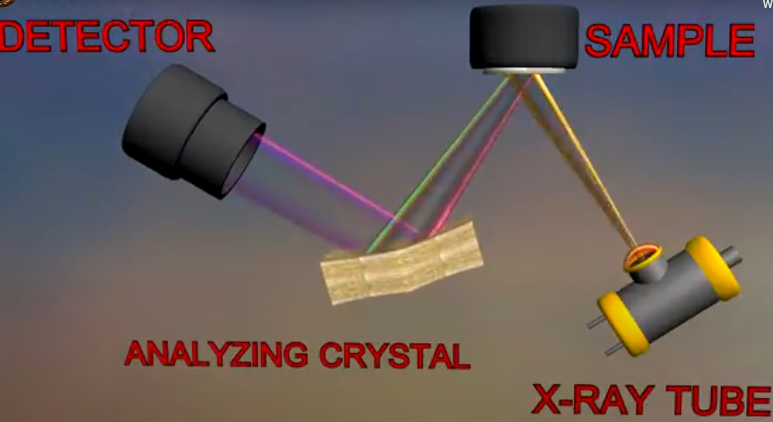
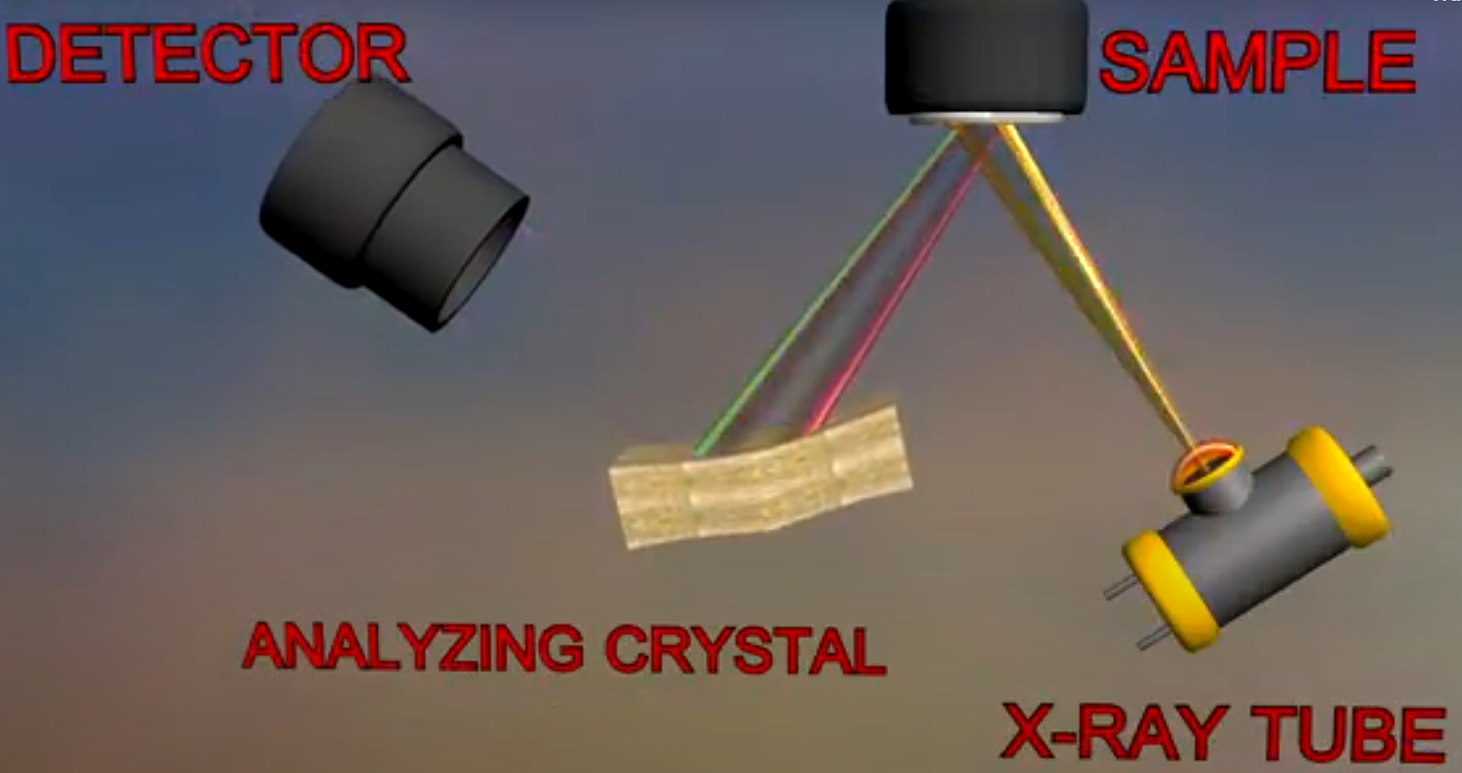
Move the detector change the angle

Slide 22
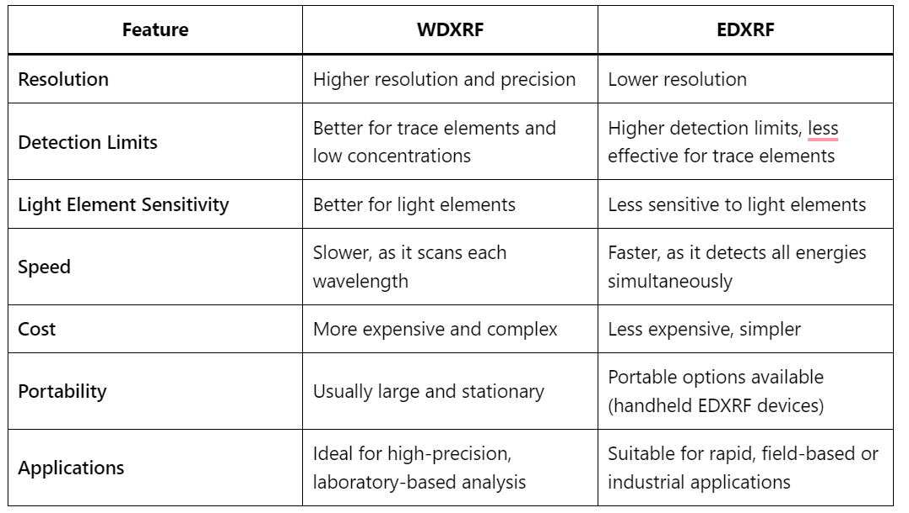

Slide 23
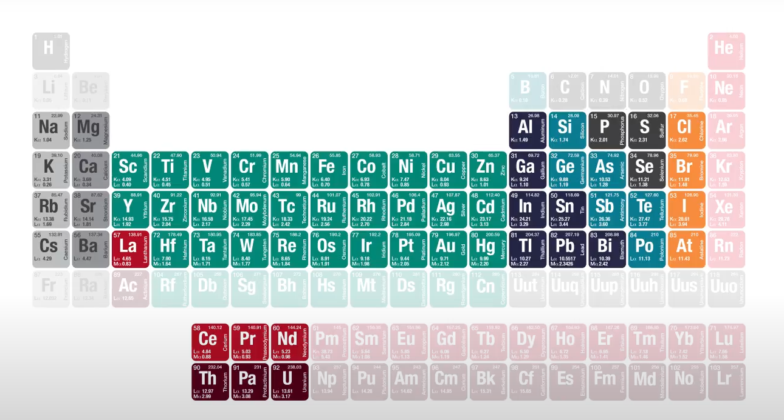
Typically analyses a range of elements from Na to U
In concentrations of ppm to high percent

Slide 24
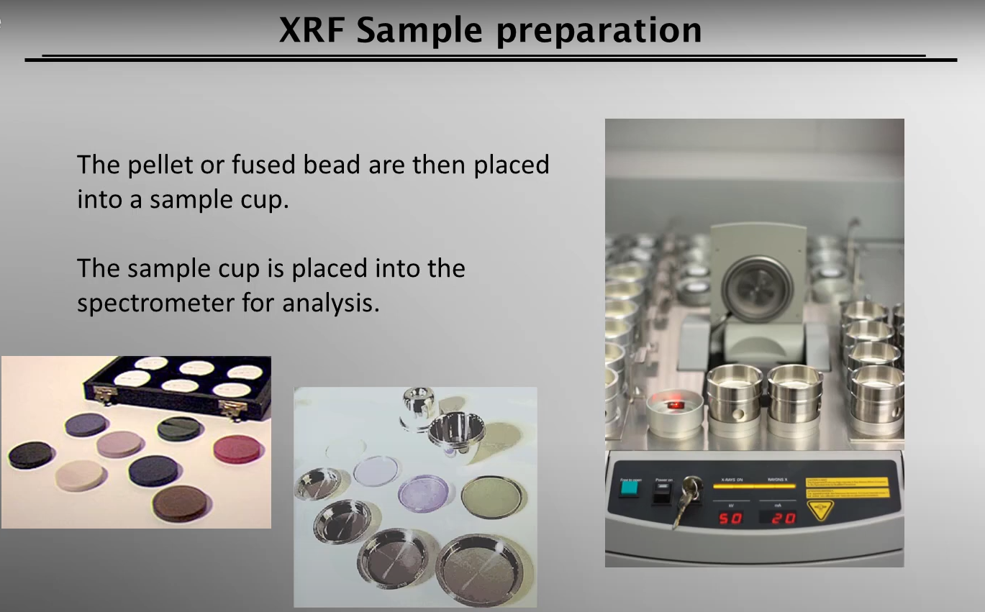

Slide 25
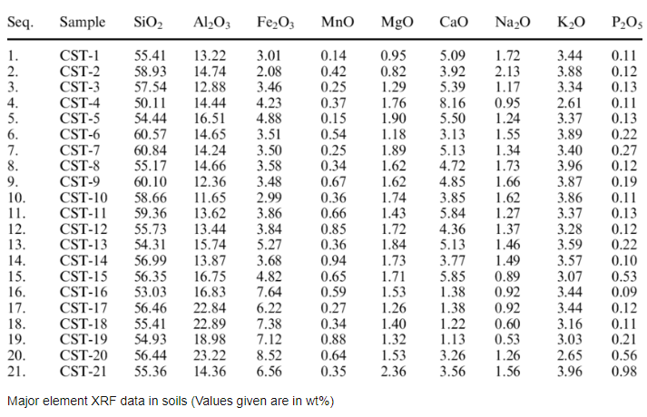

Slide 26
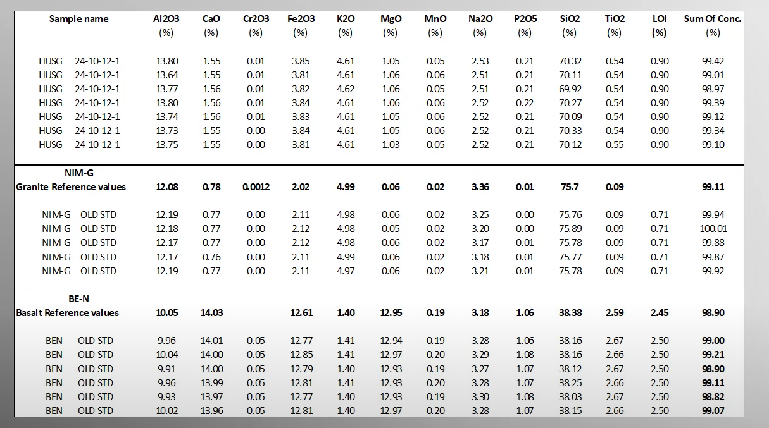

Slide 27
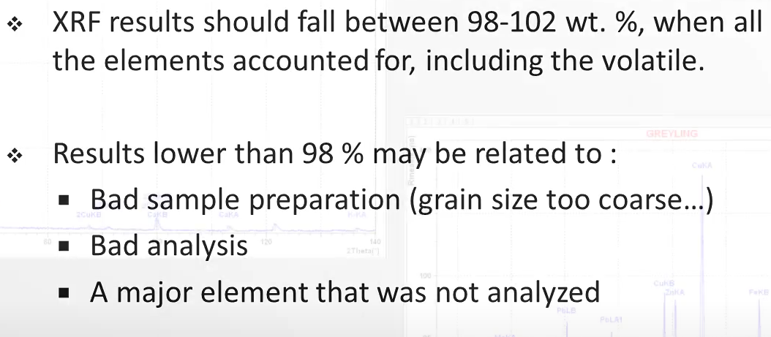

Slide 28
Applications of XRF:
Geology and Mineralogy: Used for determining the elemental composition of rocks, ores, and sediments. XRF can help in identifying mineral phases and providing data for geochemical analysis.
Environmental Analysis: Commonly used for analyzing soils and detecting heavy metals and pollutants.
Archaeology: For studying the elemental composition of artifacts, ceramics, and ancient materials, helping to trace origins and manufacturing techniques.
Material Science: For quality control in manufacturing processes, particularly in industries dealing with metals, cement, and ceramics.
Forensics: Used in criminal investigations to analyze substances or trace elements found at crime scenes.

Slide 29
Advantages of XRF:
  Non-destructive: Since no sample preparation is required beyond placing it in the XRF instrument, the technique does not damage or alter the sample.
  Rapid Analysis: Measurements are quick, often taking just a few minutes per sample.
  Versatile: It can analyse solid, liquid, and powder samples, making it useful for various materials such as rocks, metals, soils, and even archaeological artifacts.
  Portable Systems Available: Handheld XRF devices allow for in-situ measurements, making it particularly useful in field applications such as geology and mining.

Slide 30
Limitations of XRF:
Surface Sensitivity: The technique primarily analyzes the surface or near-surface layers of a sample, so deeper composition may not be detected unless the sample is specifically prepared.
Light Elements: XRF struggles to detect very light elements (like hydrogen, helium, and lithium) due to their low atomic numbers, and it can be less accurate for elements with low X-ray fluorescence energies (such as carbon, nitrogen, and oxygen).
Matrix Effects: The composition of the surrounding material (matrix) can affect the measurement, requiring calibration and correction techniques to ensure accuracy.

